Slide 1
Financial Valuation and Strategic Analysis of American Express (AXP)
By:
Amisha Gadhia
Harshan Ramesh
Siddhanth P
Vikas Sharma

Slide 2
Summary
Closing Price | $275.97
52-week High/Low | $140.91/$276.20
Average Vol traded | 2,725,067
Market Cap | 190.84B
EPS Basic | 13.41
PE Ratio | 20.39
Dividend | $2.80
Revenue | 46.6 B
Beta | 1.08
EV/Revenue | 4.12
Worlds 4th largest global card network.
Captures 4.16% market share by payment volume.
Known for providing exclusive services and personalized offers.
Premium customer base (high spending).

Slide 3
Industry Overview
Market Capitalization and Growth: Amex, with a market cap of $190.84 billion, is significantly smaller than Visa and Mastercard, reflecting its more niche market positioning. Despite this, Amex achieved a solid revenue growth rate of 10.60% in 2023, comparable to its larger rivals.
Profit Margin and ROE: Amex’s profit margin of 18.40% lags behind Visa and Mastercard, which enjoy higher margins due to their broader customer base and lower operational costs. The Return on Equity (ROE) for Amex, at 14.80%, also trails its competitors, indicating slightly lower efficiency in generating profit from its equity base.
Dividend Yield: Amex offers a higher dividend yield (1.30%) compared to Visa (0.70%) and Mastercard (0.80%), suggesting a more shareholder-friendly policy focused on returning capital to investors.

Slide 4
What We have done
Analyzed Income Statement & Balance sheet
Factors Affecting Revenue
Projected the financials for next 10 years
Use models like DCF valuation and Relative valuation to predict the stock price
JEFF BEZOS
Founder

Slide 5
Financial Ratios

Slide 6
INCOME STATEMENT

Slide 7
What Affects Revenue?
Evaluating the Regression Model for American Express Revenue Prediction
Key Findings:
Strong Predictive Power: The regression model demonstrates strong predictive power with an R-squared value of 99%, indicating that 99% of the variation in American Express's revenue can be explained by the independent variables (CPI, Federal Reserve rates, unemployment, etc.).
Robustness: The adjusted R-squared value of 99% suggests that the model is robust and not overfitted, even when considering the number of independent variables.
Interpretation of Independent Variables:
CPI: A positive coefficient for CPI would indicate that higher inflation rates are associated with higher revenue for American Express, potentially due to increased consumer spending and higher interest rates on credit card balances.
Federal Reserve Rates: a negative coefficient indicates that higher interest rates could deter consumer spending and reduce revenue.
Unemployment: A negative coefficient for unemployment would likely indicate that lower unemployment rates (stronger economy) correlate with higher consumer spending and increased revenue for American Express.

Slide 9
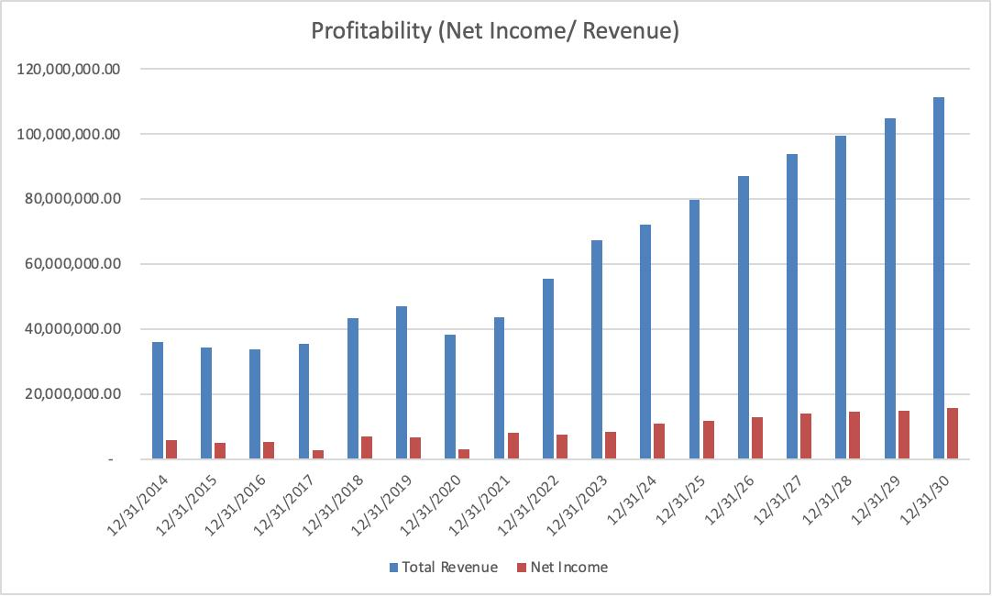
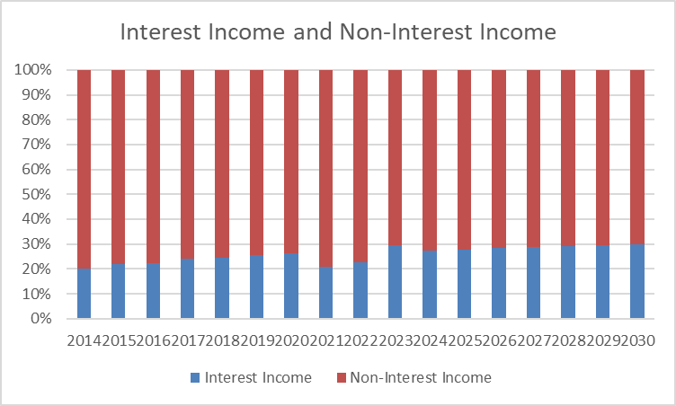

Slide 10
Balance Sheet

Slide 11
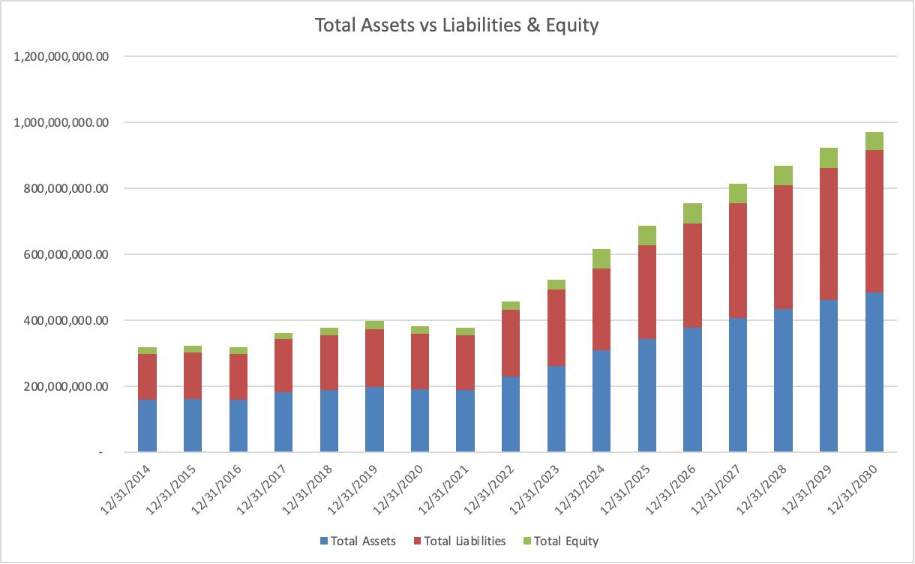

Slide 12
Industry Analysis and Competitive Positioning

Slide 13
Competitive Advantage
Premium Customer Base: Cardholders typically have higher average annual spending compared to cardholders of other major credit card companies.
High Spending Customer: Cardholders frequently engage in luxury spending, such as travel, dining, and entertainment.
Closed Loop Payment Solutions: While American Express may have a smaller merchant acceptance network compared to Visa and Mastercard, it has a strong presence in high-end retailers and luxury brands.
Metric | American Express | Competitors
Average Annual Spending | $25,000 | $15,000
Average Income | $120,000 | $80,000
Percentage of Luxury Spending | 25% | 15%
Average Transaction Value | $200 | $100

Slide 14
Relative Valuation
 | AXP | PYPL | DISCOVER | COF | Average
P/E (forward or last earnings) | 14.64 | 33.47 | 5.24 | 8.83 | 15.85
EBITDA multiplier | 7.43 | 13.73 | 6.97 | 5.24 | 8.65
Revenue multiplier | 2.32 | 26.13 | 2.04 | 1.96 | 10.04
Book Value multiplier | 4.10 | 3.93 | 1.95 | 3.33 | 3.07

Slide 15
DCF Model
lm(formula = Revenue ~ cpiu + unemployment_rate + fed_funds_rate, data = df)
 | 2021 | 2022 | 2023 | 2024 | 2025 | 2026 | 2027 | 2028 | 2029 | 2030
External Factors
Risk Free Rate | 2.20% | 2.20% | 2.20% | 2.75% | 3% | 3.50% | 3.70% | 3.70% | 3.70% | 3.70%
Market risk premium | 7.75% | 7.75% | 7.75% | 7.75% | 7% | 7% | 7% | 7% | 7% | 7%
Interest rate on debt (cost of debt) | 3% | 6% | 6% | 6% | 6% | 6% | 6% | 6% | 6% | 6%
Annual sales growth | 14.35% | 27.40% | 21.10% | 7.02% | 10.55% | 9.38% | 7.76% | 6.00% | 5.33% | 6.15%
Cost of equity | 4.60% | 11.97% | 13.36% | 11.12% | 10.56% | 11.06% | 11.26% | 11.26% | 11.26% | 11.26%
Capital Structure (% debt) | 87.20% | 86.14% | 85.30% | 81.50% | 83.66% | 85.44% | 86.79% | 87.80% | 88.65% | 89.47%
WACC (discount rate) | 2.77% | 6.04% | 11.69% | 10.27% | 9.92% | 9.98% | 9.99% | 9.98% | 9.97% | 9.95%
Perpetual CF growth |  |  | 3%
Perpetual discount |  |  | 9.95%

Slide 16
Relative Evaluation
Evaluated Stock Price : $ 343.20
An undervalued stock with strong potential for high returns – a great choice to invest in or hold!
Risks
Regulatory changes: New laws or regulations could affect fee structures, interest rates, or other aspects of business operations.
Credit risk: Defaults on credit card balances during economic instability can harm profitability.
Future Projection and Target
The financial projections from 2024 to 2030 indicate strong revenue growth, effective cost management, and increasing profitability. The company’s balance sheet will continue to strengthen, and rising free cash flow provides flexibility for future investments and shareholder returns. Overall, the company is expected to maintain a solid financial position, ensuring its long-term success.

Slide 17
Recommendation
Current Price:
$ 273.79
DCF Model
$ 343.20
LET’S BUY!

Slide 18
Appendix

Slide 19
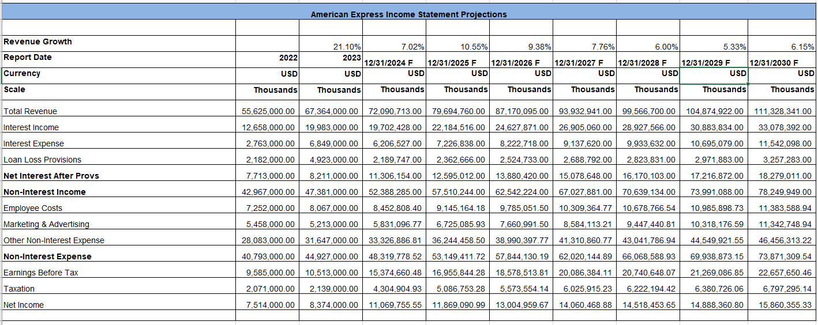
Income Statement:

Slide 20
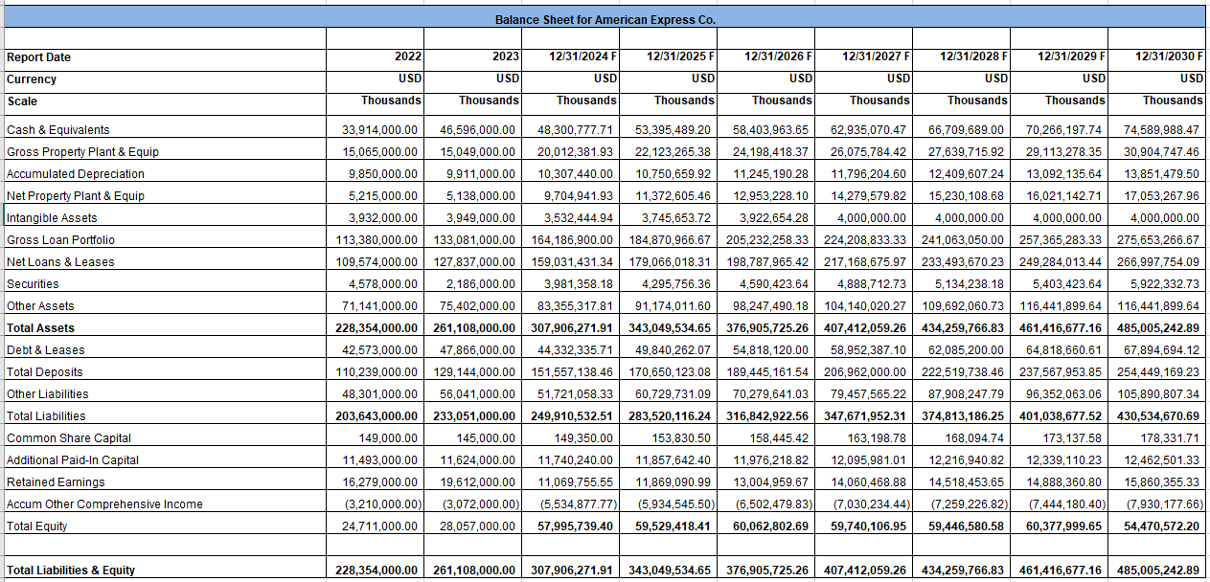
Balance Sheet

